Slide 1
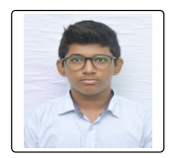

Student Details
Name : NAGOTHU HEMANTH NIRMAL KUMAR
SkillsBuild Email ID : hemanthnk04@gmail.com
College Name : Velagapudi Ramakrishna Siddhartha Engineering College
College State : Andhra Pradesh
Internship Domain : Artificial Intelligence
Internship Start and End date : 18th August 2023 to 3rd October 2023 (18-08-2023 to 3-10-2023)

Slide 2
PROJECT TITLE/Problem Statement
The project title is
Sentiment Analysis of Restaurant Reviews

Slide 3
AGENDA
Here in this Presentation I will mainly explain about the following things:
What the project is about?
Who are the end users?
How I am going to solve it?
These are the main things and I will delve into it deeply if needed as we go.

Slide 4
PROJECT OVERVIEW
The project title is ‘Sentiment Analysis of Restaurant Reviews’.
Here we are given a review set of a Restaurant which contains 1000 reviews. In that positive review is assigned value ‘1’ and negative review is assigned value ‘0’.
Now we have to use ‘Natural Language Processing’ and design a model which can predict the reviews based on the given data.
But no model is 100% accurate. So we have to create a model which gives maximum accuracy and without overfitting.
This model will be able predict whether the review given is a positive review or negative review .

Slide 5
WHO ARE THE END USERS of this project?
The end users of this project are Restaurant management.
They are the one’s responsible for the managing of Restaurant.
So they need to identify the reviews customers gives them to improve/correct themselves.
It is a necessary work for them.
With this project they don’t have to read all the reviews to understand them.
The model will analyze the reviews and will them if it’s a positive review or negative review.
This will reduce their work load and increases their efficiency.

Slide 6
YOUR SOLUTION AND ITS VALUE PROPOSITION
Here for the above problem, I am going to follow the below approach to solve it
First I will take the data set of the restaurant reviews and I will first observe it.
Now with some NLP libraries I will remove stopwords and punctuations in the reviews.
After that I will convert it into numerical data using Count vectorizer technique.
Then I will machine learning algorithm to predict the reviews with maximum accuracy and without overfitting.

Slide 7
How did you customize the project and make it your own
Here first I am going to take the review set first then I will clearly observe it once.
Then I will use google colab to do the project.
Here first I will observe the info and other things about the data set.
Then I will use nltk and String libraries to remove the stopwords and punctuations.
Later I will use Count vectorizer technique to convert it into numerical data.
After that I will use the machine learning models that will give me maximum accuracy and without overfitting.
We can use one model/algorithm that fits our needs. But here in this project I will use three algorithms.
The models I am using are BernoulliNB from naïve bayes, XGboost and SVC.

Slide 8
MODELLING
Here in this project I am using count vectorizer to convert the data set into numerical data.
Here I am using three machine learning algorithms i.e, BernoulliNB, XGboost and SVC. Now lets see what I had done to reduce overfitting and get maximum accuracy.
First in BernoulliNB, I used hyper parameter tuning to adjust alpha value to reduce overfitting and get maximum accuracy.
In XGboost, I used hyper parameter tuning to adjust alpha and gamma to reduce overfitting and get maximum accuracy.
In SVC, I set kernal as linear and adjusted C parameter value to 0.1 cause it reduces overfitting and get maximum accuracy. I also cheaked other values for C but 0.1 gives us necessary results.

Slide 9
Results
Now I will show the results of the algorithms and will also show the hyper parameter tuning results also.
I will show the results of the algorithms one by one.
I will show the test accuracy and other values along with train accuracy and other values.

Slide 10
BernoulliNb
Here I will show the results of “BernoulliNB” algorithm from Naive bayes.
Here I had put alpha as 0.3.
The test accuracy is 76%.
The train accuracy is 77.25%.
Here there is so small difference in between train accuracy and test accuracy and both are above 70%.

Slide 11
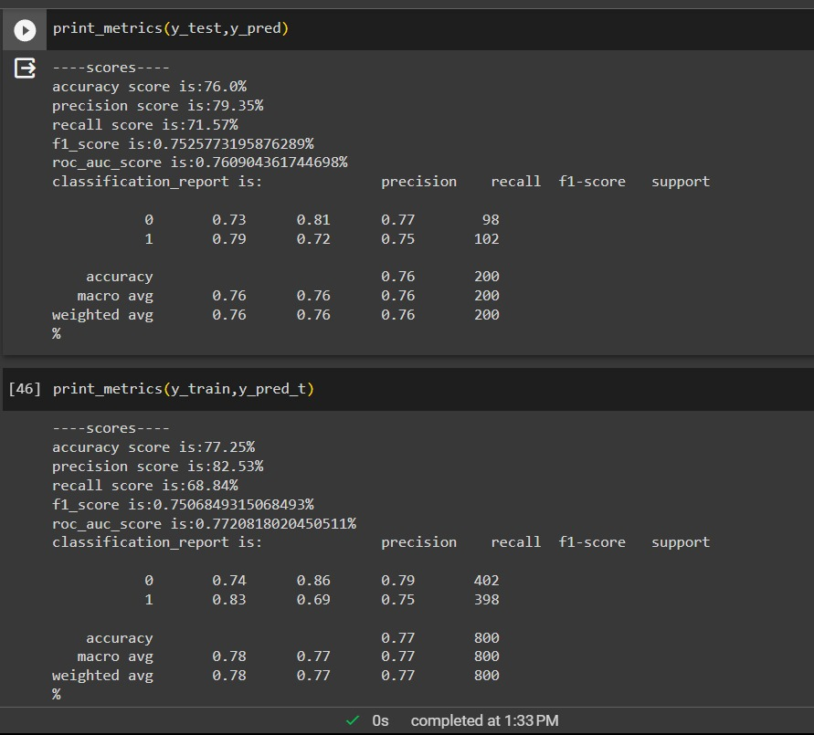

Slide 12
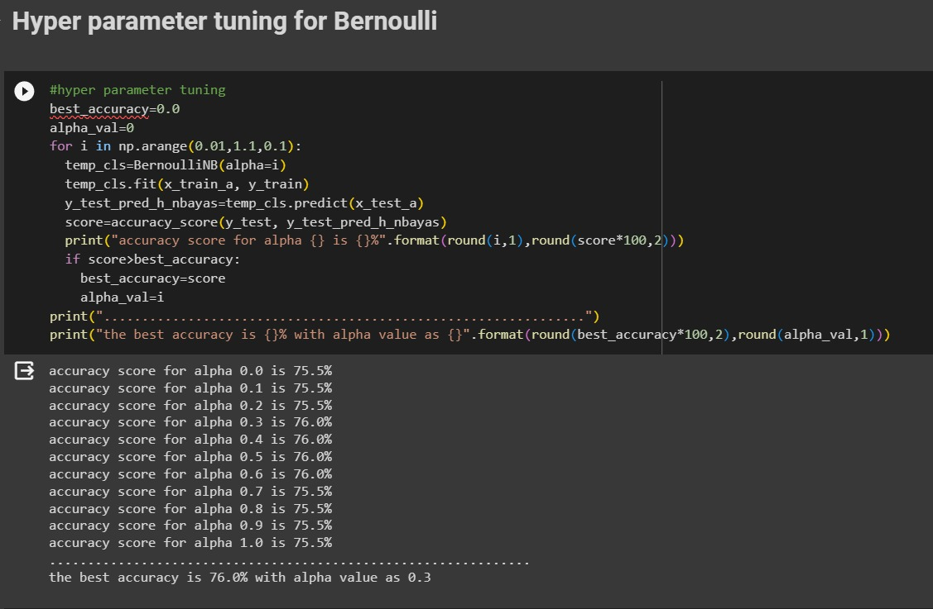

Slide 13
svc
SVC stands for Support Vector Classification.
Now I will show the results for SVC algorithm.
Here I set C value as 0.1 because it gives maximum accuracy without overfitting.
And here I set kernal parameter as ‘linear’.
The test accuracy is 73.5%.
The train accuracy is 77.88%.
Here there is so small difference in between train accuracy and test accuracy and both are above 70%.

Slide 14
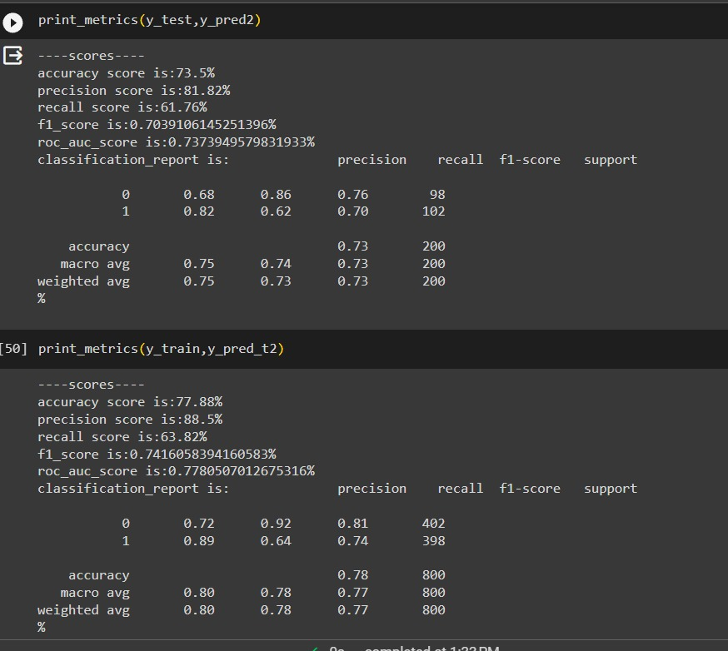

Slide 15
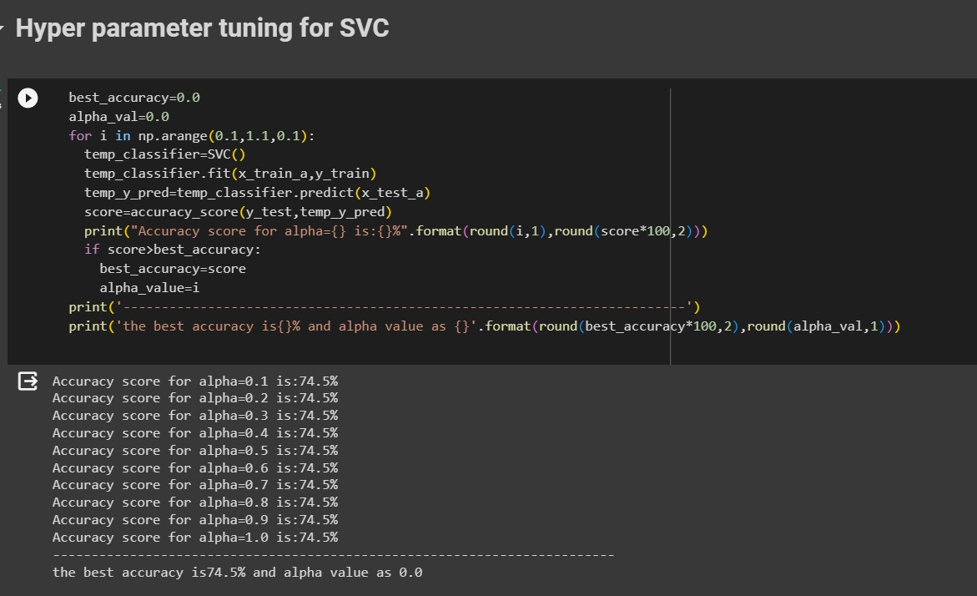

Slide 16
rANDOMfORESTcLASSIFER
Now I will show the results of the “RANDOMFOREST” algorithm.
In this I put alpha value as 0.0.
The test accuracy is 75.5%.
The train accuracy is 83.62%
Here there is so small difference in between train accuracy and test accuracy and both are above 70%.

Slide 17
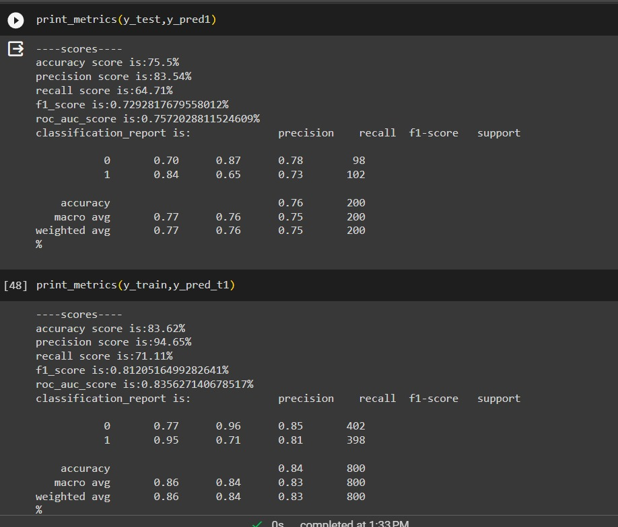

Slide 18
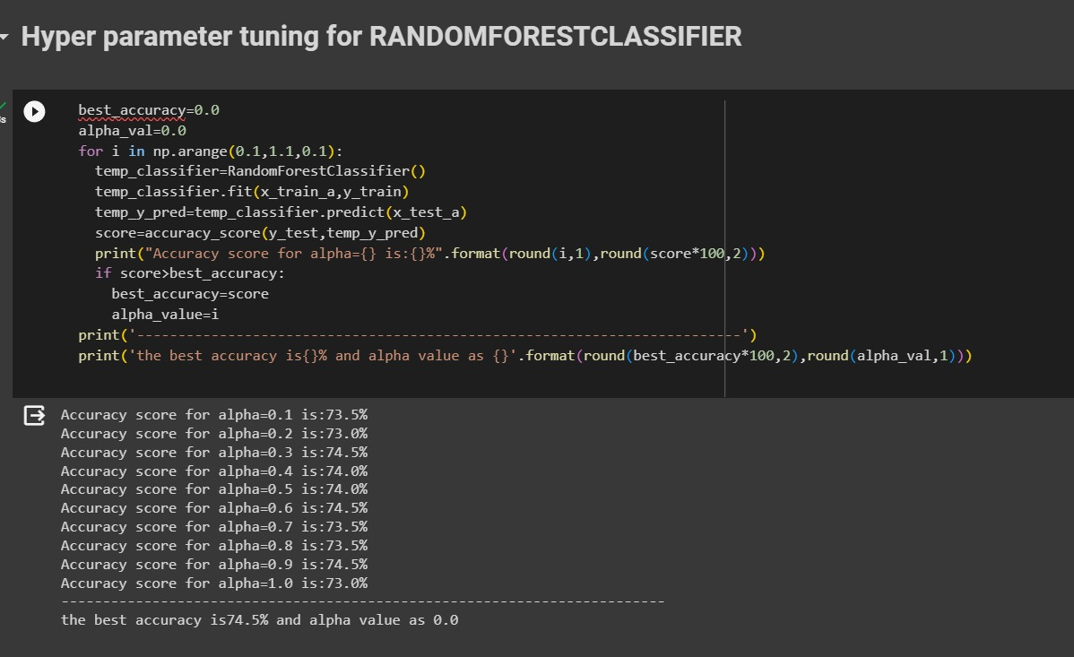

Slide 19
links
Here I am providing the my google colab project link.
https://colab.research.google.com/drive/10Yr9lBLei7HewJDBNTBLjFO1TWqKdIjY?usp=sharing

